Slide 1

A Cost-Centred Approach to Autonomous Litter Collection
James Heselden
University of Lincoln
Implementation Demonstration
VIVA Presentation

Slide 2
Background
Littering has become an increasingly worsening problem over the last decade, and autonomy presents a potential solution to this in the form of autonomous robotics.
The largest setback to the development of robotic systems as consumer-ready products is cost and maintenance, as these systems are often designed to be very self-sufficient, and thus components are highly integrated.
Managing the product costs can be an effective tool for widening the accessibility of autonomous systems in industries.

Slide 3
Approach
The system structure was the main focus within the project, and many considerations had to be made with regard to reducing the costs.
These include the complexity of the robot, where elements such as the localisation which usually require integrated setups with expensive components were not viable, so alternatives were found.

Slide 4
System Structure
Main PC
Robot Module
Background
Extraction
Relative
Geo-Position
System
Robot
▲
Frames
▲
Objects
▲
Instruction
Background
▼
Position
▼
Download
Updates
Data
Storage
Robot
Handler
Camera
◄ Frames
Frame +BG ►
Instructions ►
▲
Frame
▲
Labelled Objects
Image Stream
▼
BG + Frame
▼
Raspberry Pi
Foreground
Extraction
System
Server
Google
Vision API
Frame ►
◄ Labels
Object ►
Camera Module
Server Module
Google Cloud

Slide 5
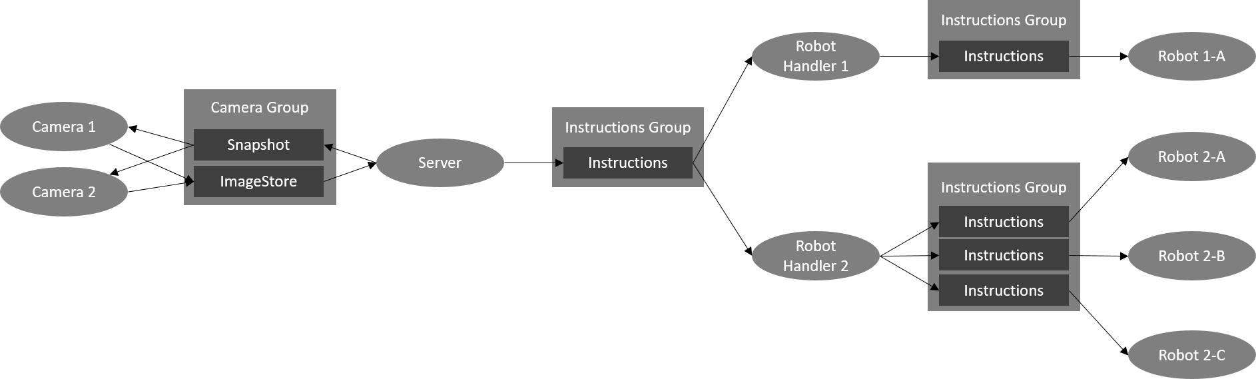
ROS Network

Slide 6
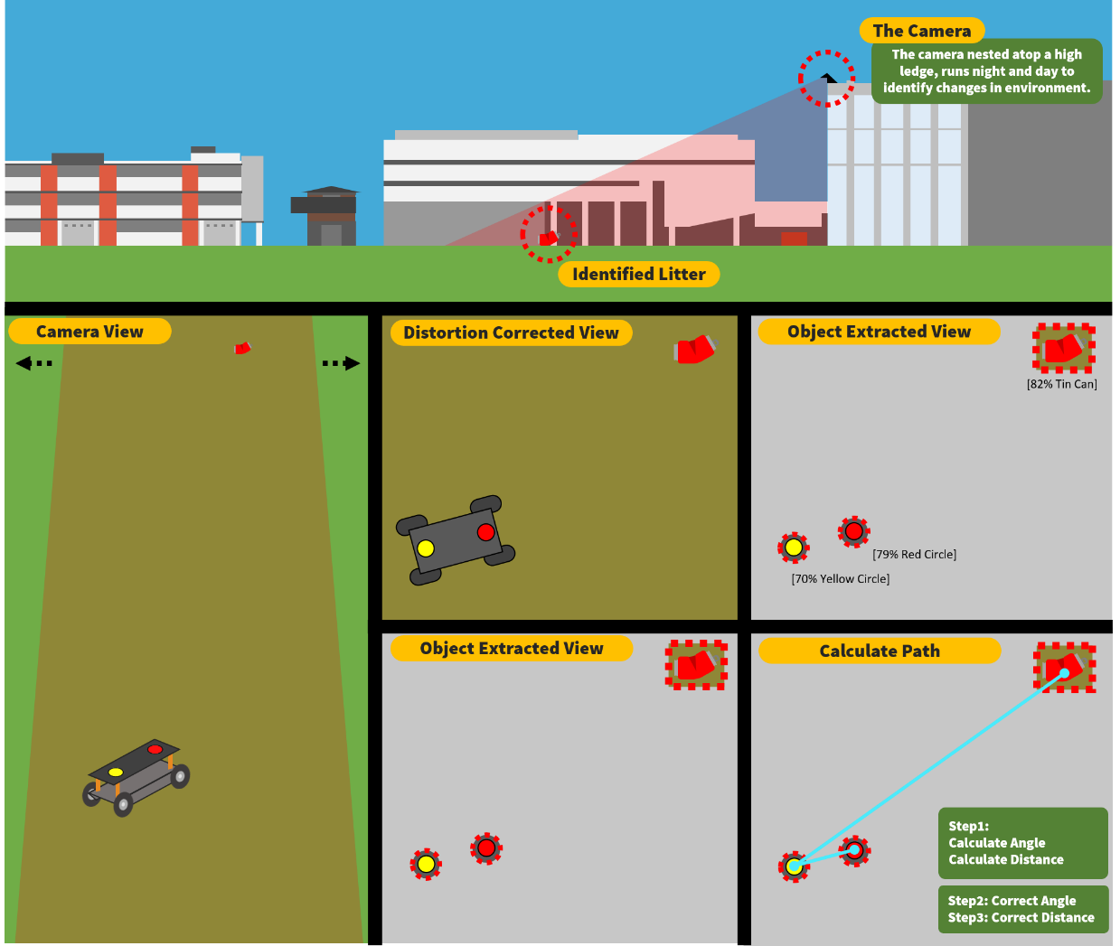
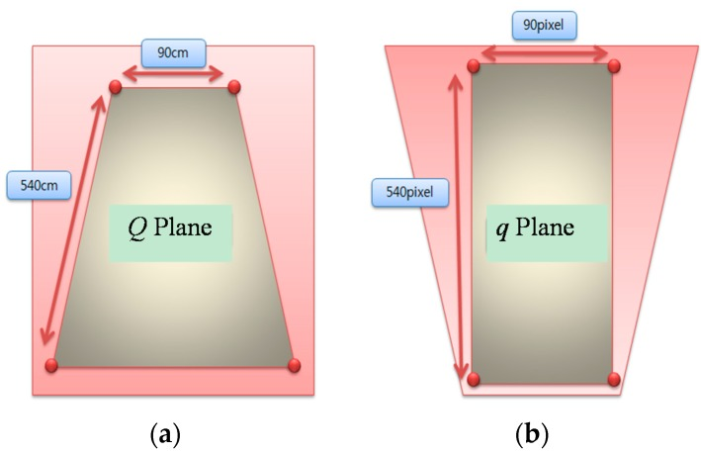
System Functionality
Shim, J. and Cho, Y., (2016). A mobile robot localization via indoor fixed remote surveillance cameras. Sensors, 16(2), 195

Slide 7
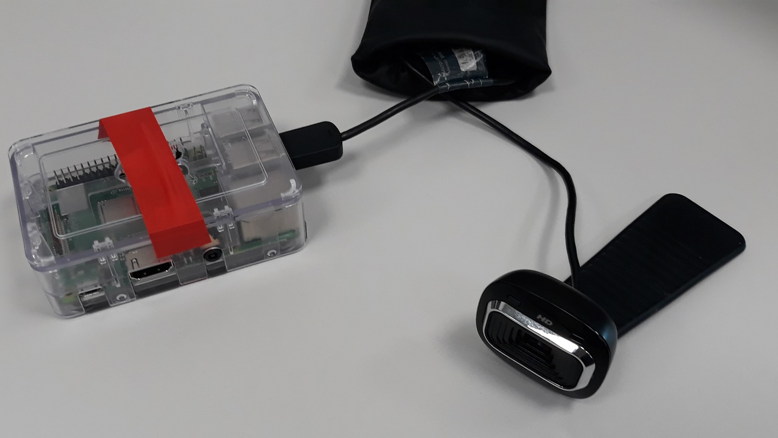
Camera Setup
Distortion correction is designed to use homography to correct the image distortion from an angular plane.
Shim, J. and Cho, Y., (2016). A mobile robot localization via indoor fixed remote surveillance cameras. Sensors, 16(2), 195

Slide 8
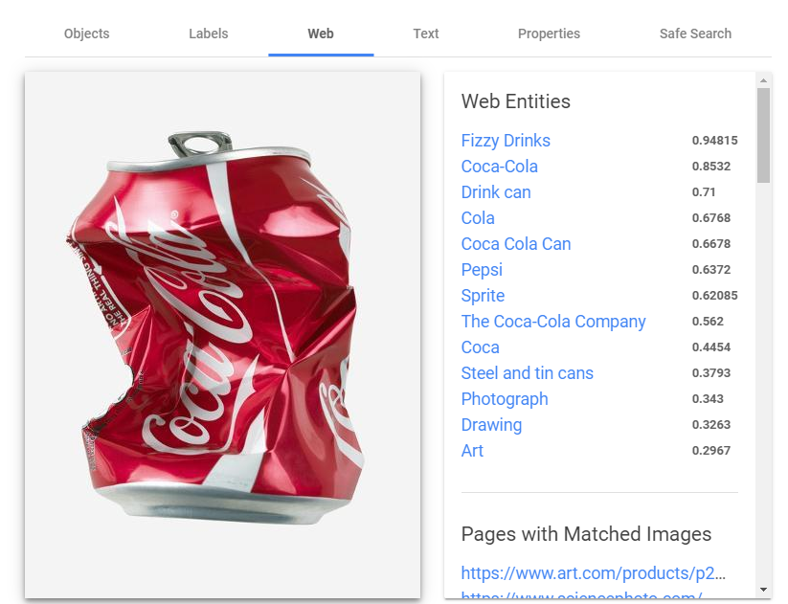
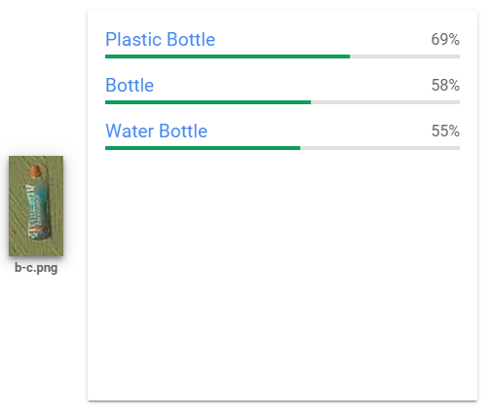
Google Vision API Results

Slide 9
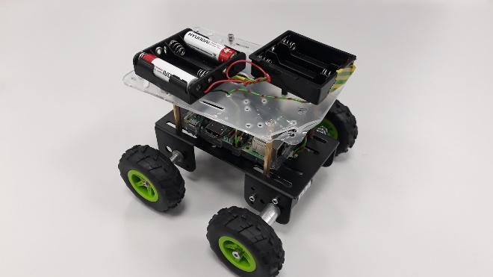
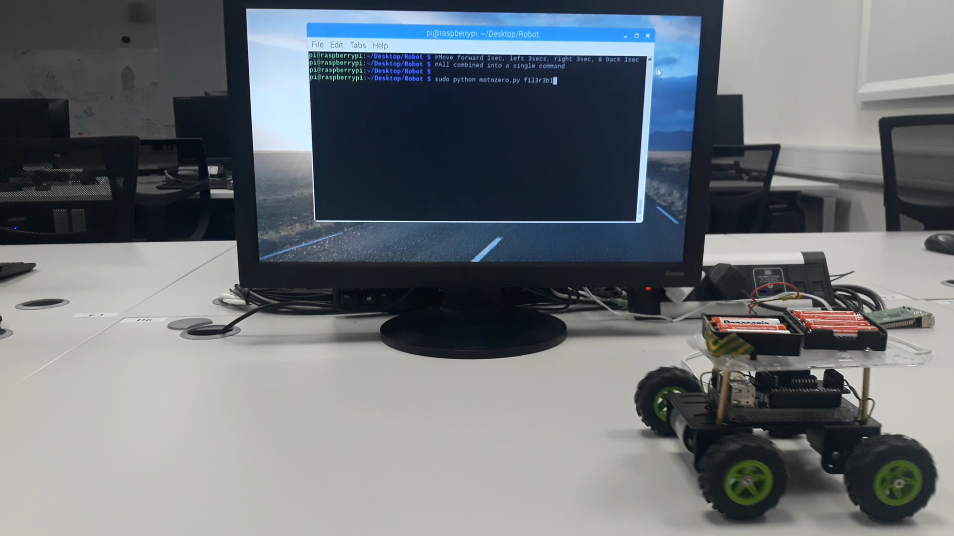
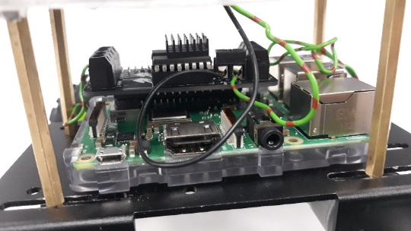
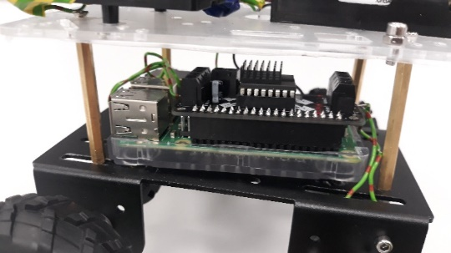
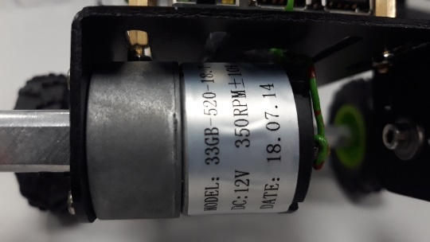
Robot

Slide 10
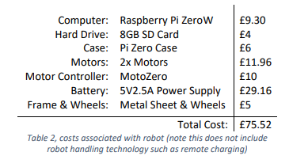
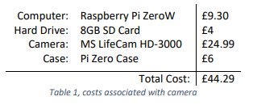
Results
Camera Costs
Robot Costs
Conclusion
When compared with the usual costs from organisations for autonomous systems such as this, the results shown here, as an upper bound cost estimate are very appropriate towards meeting the aim.

Slide 11
Future Work
Further development of the system includes:
Inclusion of a Deep Convolutional Neural Network for litter detection.
Removal of MATLAB for image processing in favour of a cheaper alternative.
Creation of robot frame from scratch.
Inclusion of additional help from designers for robot aesthetic improvements.

